Slide 1
Hands-on Workshop: Deep-dive Review and Testing of CDISC Analysis Results Standards Logical Model and Schema
PHUSE US Connect: March 06, 2023
Bhavin Busa, Clinical Data SME, Independent
Bess LeRoy, MPH, Head of Standards Innovation, CDISC
Richard Marshall, Principal Data Modeler, CDISC

Slide 2
Agenda
Background
Use Cases for Analysis Results Standards
Analysis Results Key Objectives and Key Results
Analysis Results Logical Metamodel
Representations of model in CMAP, Markdown, and JSON Schema
ARS Development on GitHub
Review Examples
Reference implementation
ARS Roadmap
Q&A

Slide 3
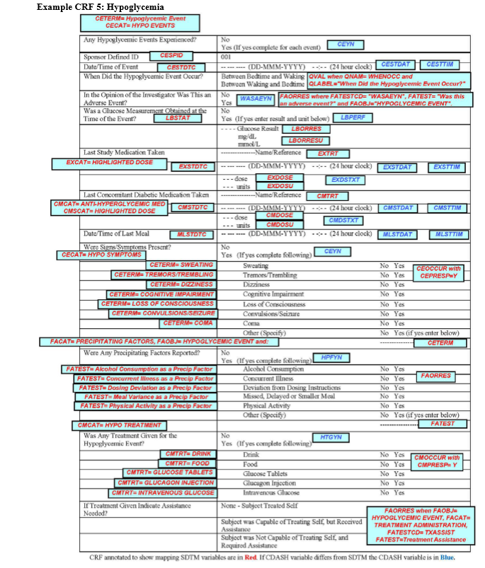
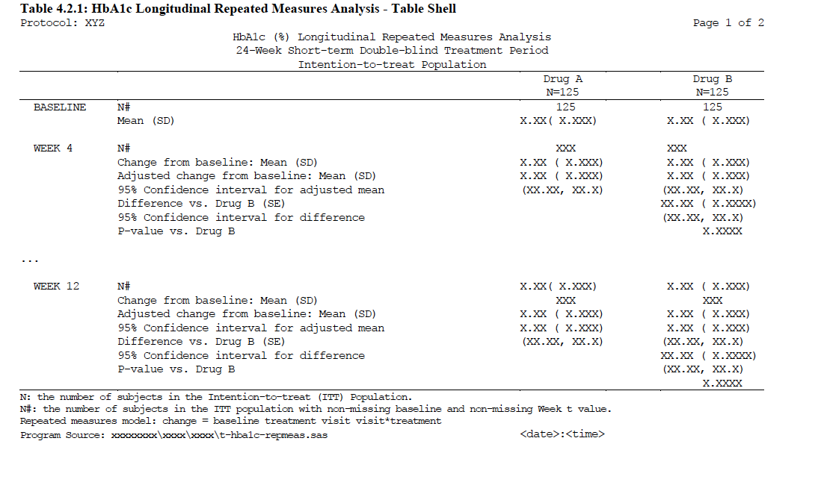
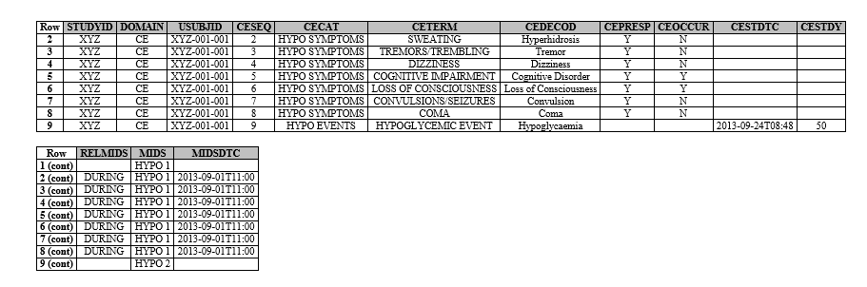
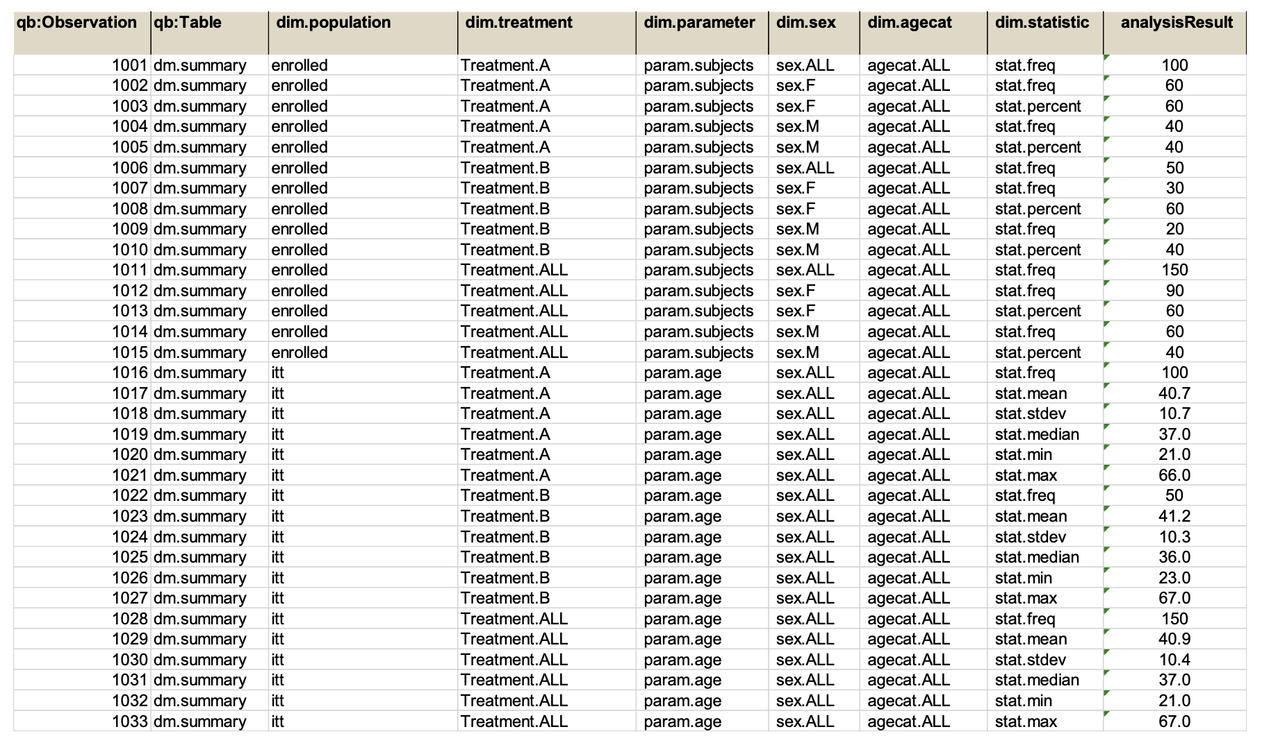
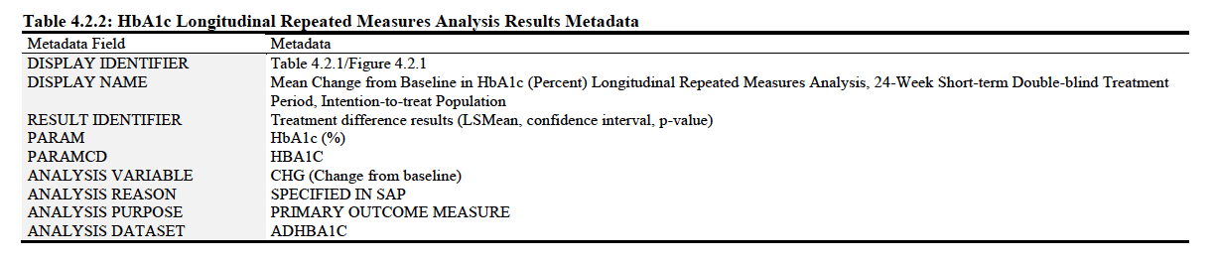
CDISC Foundational Standards
Data Collection
Data Aggregation
Analysis
Results
CDASH
SDTM
ADaM
???
ARM for Define.XML

Slide 4
Use Cases for Analysis Results Standards
Use Case 01:
As an analyst, I need a technical specifications to prospectively specify analysis results metadata for data displays to facilitate and automate the planning and production of results
Use Case 02:
As an analyst, I need a structure to represent analysis results and qualifying metadata to support traceability, reproducibility, reusability and quality
Notes:
Current Capabilities:
Downstream groups must rely on programming needs to create all outputs
Must re-create complex analysis each time from ADAM datasets
Increased chance for error, added time, and bottleneck in programming group
Future Extensions:
Downstream groups can easily consume Analysis Result Dataset directly without relying on programming group
Complex analyses done once
Decreased chance for error, more efficient use of time, and less reliance on programming group for downstream activities

Slide 5
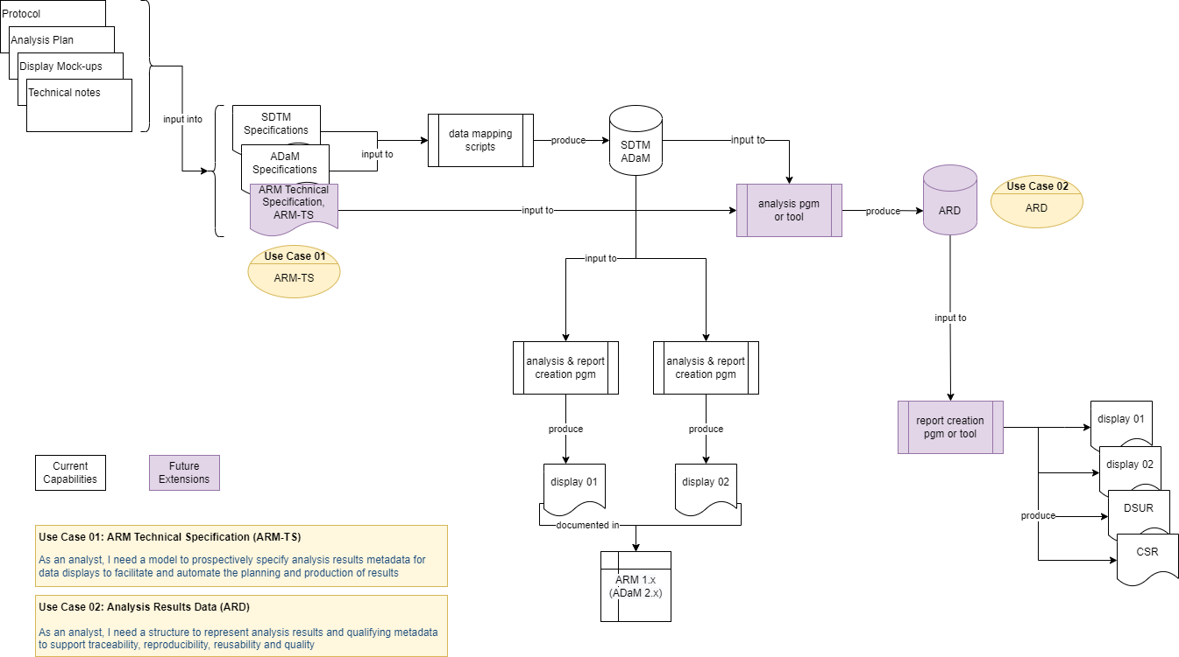
Workflow with Future Extensions
Notes:
Current Capabilities:
Downstream groups must rely on programming needs to create all outputs
Must re-create complex analysis each time from ADAM datasets
Increased chance for error, added time, and bottleneck in programming group
Future Extensions:
Downstream groups can easily consume Analysis Result Dataset directly without relying on programming group
Complex analyses done once
Decreased chance for error, more efficient use of time, and less reliance on programming group for downstream activities

Slide 6
Analysis Results Key Objectives
Use analysis results metadata to drive the automation of results
Support storage, access, processing and reproducibility of results
Improved navigation and reusability of analyses and results
Traceability to Protocol/SAP and to input ADaM data

Slide 7
Initial Analysis Results Standards Key Results
Develop a structure to represent Analysis Results as data
Illustrate and exercise with a set of common data displays
Develop a technical specification to prospectively leverage Analysis Results Metadata to drive automation

Slide 8
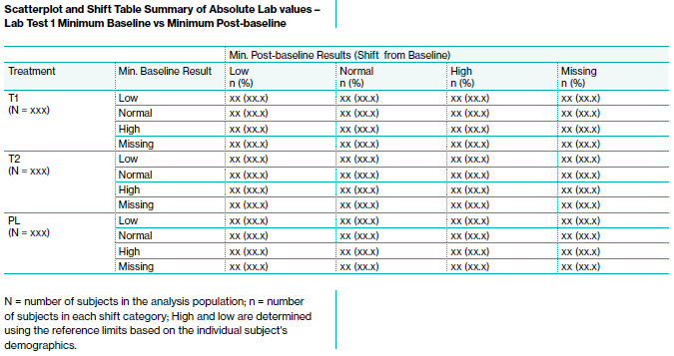
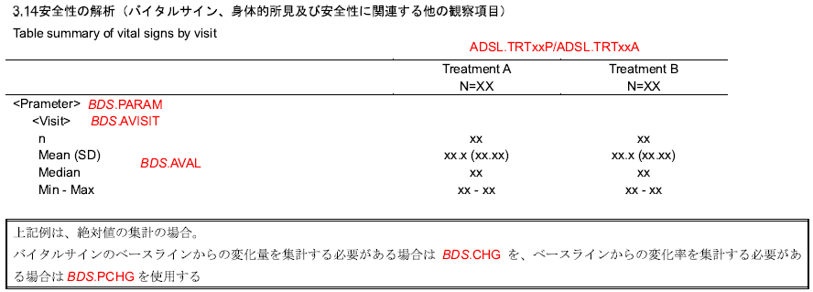
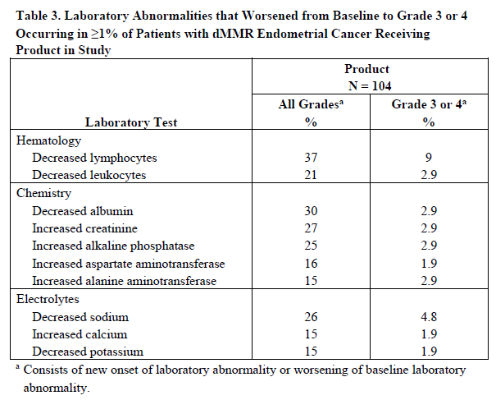
Concepts Team Consulted Published Layouts
PHUSE / FDA Working Group on Standard Analyses
White papers published by PHUSE
https://phuse.global/Deliverables/1
Summary tables can range from common (familiar) to thoughtfully innovative
JPMA commonly used tables and ADaM annotations
Recent FDA publications
Sub-team knowledge of sponsor variations

Slide 9
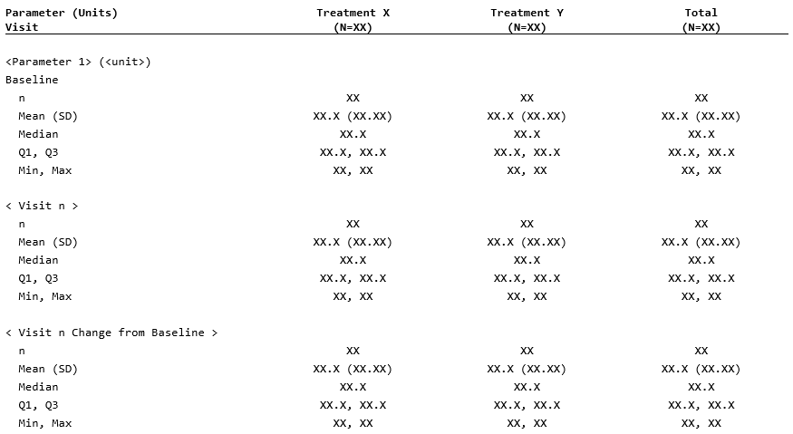
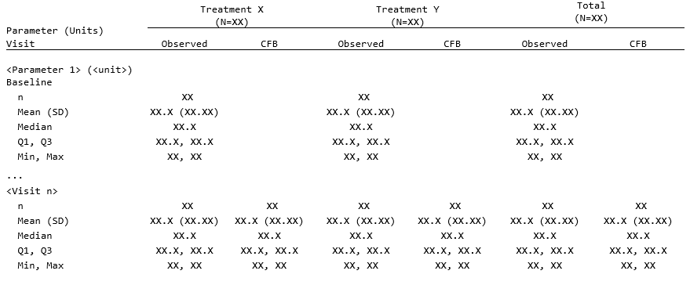
Focus on Concepts, Not Layout
ARS teams focus on concepts presented in data displays not on subjective layout and formatting of displays
Representative displays therefore condense concepts
For example, side-by-side Visit and Change-from-baseline summaries consolidates more concepts into an easy-to-read summary table

Slide 10
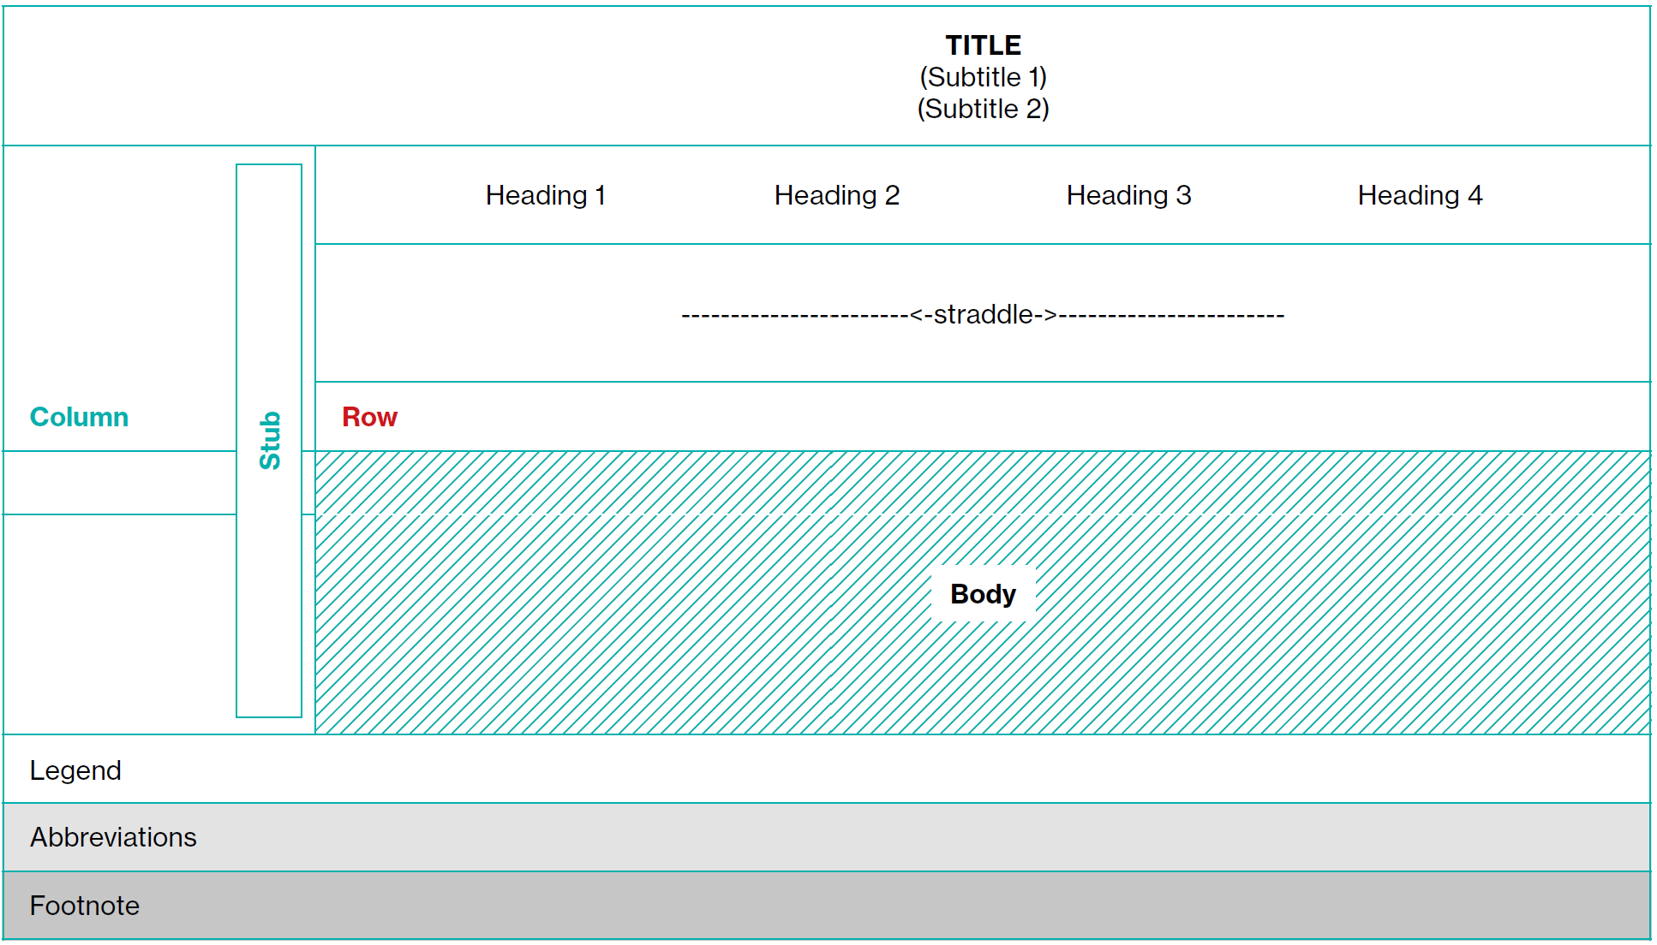
Key Metadata Elements of a Table
Output
Display Template
Title
Analysis Set
Display
Analysis Group
Result Group
Result Variable
Where Clause
Result Statistics
Result
Legend
Abbreviations
Display
Footnote
Reference: PHUSE White Paper “General Output Tips and Considerations”, Doc ID: WP-034, Version 1.0, Aug 2020

Slide 11
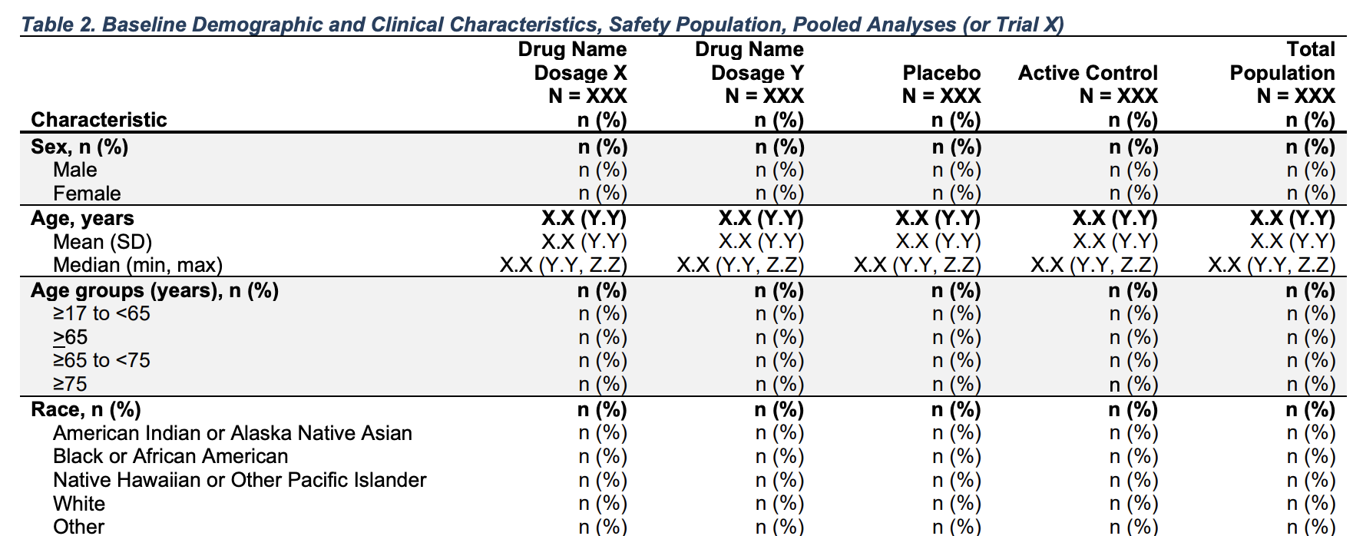
Demographics Analysis Results and Metadata
Display Template
Title
Analysis Set
Analysis Group
Result Group
Result Variable
Where Clause
Result Statistics
Footnote
Abbreviations
Legend

Slide 12
Analysis Results and Associated Metadata Example
Identifiers |  | Analysis Group |  |  | Result Variable |  |  | Results Statistic
Name | Title | Dataset | Variable | Value | Variable | Value | Label | Value | Name | Label
Table 2 | Baseline Demographics and Clinical Characteristics, Safety Population | ADSL | TR01X | Drug Name Dosage X | SEX | M | Male | 53 | Count | n
Table 2 | Baseline Demographics and Clinical Characteristics, Safety Population | ADSL | TR01X | Drug Name Dosage X | SEX | M | Male | 61.6 | Percent | %
Table 2 | Baseline Demographics and Clinical Characteristics, Safety Population | ADSL | TR01X | Drug Name Dosage X | SEX | F | Female | 33 | Count | n
Table 2 | Baseline Demographics and Clinical Characteristics, Safety Population | ADSL | TR01X | Drug Name Dosage X | SEX | F | Female | 38.4 | Percent | %

Slide 13
Moving Towards a Logical Model
Logical model that describes analysis results and associated metadata which will support:
Analysis Results Metadata Technical Specification (ARM-TS), to support automation, traceability, and creation of data displays
Define an Analysis Results Data (ARD) structure, to support reuse, reproducibility, and traceability of results data
Model definition and documentation
Illustrate and exercise with a common safety displays
Vital signs
Demographics
Adverse Events

Slide 14
Q & A

Slide 15
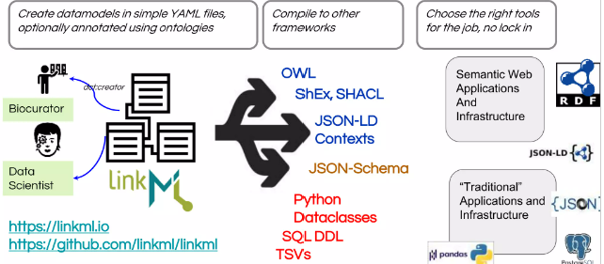
Using LinkML to Create Analysis Results Model
LinkML is a general-purpose modeling language that can be used with linked data, JSON, and other formalisms
LinkML
Landscape
Reference: https://www.slideshare.net/cmungall/linkml-intro-july-2022pptx
Notes:
LinkML is a general-purpose modeling language that can be used with linked data, JSON, and other formalisms
Model via authoring YAML files
Linked Data is JSON-ready
The LinkML Generator framework generates downstream artifacts, including JSON-Schema, ShEx, RDF, OWL, GraphQL, and SQL DD
LinkML is a linked data modeling language following object-oriented and ontological principles. LinkML models are typically authored in YAML, and can be converted to other schema representation formats such as JSON or RDF.
LinkML is a flexible modeling language that allows you to author schemas (“models”) in YAML that describe the structure of your data. The language is designed to allow for both simple use cases such as describing the column headers in a spreadsheet through to creating a complex interlinked schema.
LinkML is designed to work in harmony with other frameworks, including both semantic RDF-based frameworks, as well as frameworks that are more familiar to developers such as JSON.

Slide 16
ARS Model Representation using CMAP (DRAFT)

Slide 17
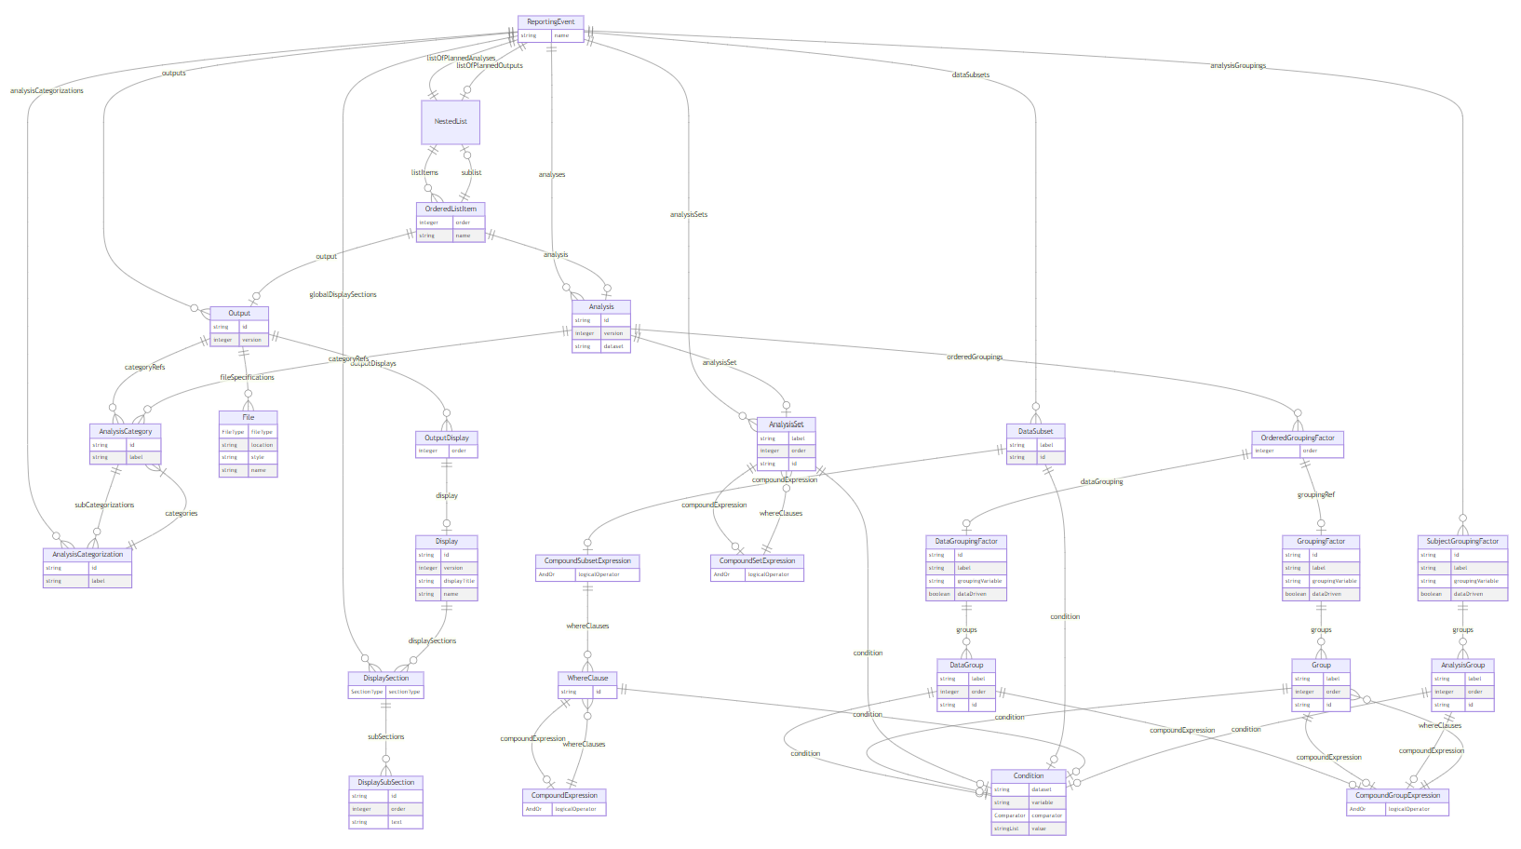
ARS Model Representation using Markdown (DRAFT)
Notes:
Markdown link:
https://mermaid.live/edit#pako:eNrNWN1u2yAUfhXL1-0L5K7qzzRpW6al2qQpN8Q-SZkwWIC7Zk3efWAgBhtTlnbacpHY8H3nn8NRnsuK1VAuSuA3GO04ata0UJ8v0DIuMd3dPgKVxbNZ1R8huVouKGqgKMzyUf8sO9l2HtLicO1QRYGphB3w4hG4wIyajZ58RRHZCyyukUIwvk-KsUsEbYDMy8C_kNRKzpBkXLnBoiXIM8WZz3itvgf4BJjruoetjYx7LAlMNodY-_pWUIUO2oX7fQuF8J6nzG4zISds9vz1kBKepCf6DivDT9L0W6976x4mMWeVyc94Q8j9yyFwuX5dzJFEAnwnltpTqN9x1rUKcYcqyXhGAShBc5ysqvNWd1bOV8Qx2viR2DBGANHe7BuO1bmMmTDRPFKTTqozs5d5zZqWddSE4_ap5SBEUDNXtF5ylckdrhBZtsCRdn0Q8PYG0RpHyzZIpbf-OImidgoZQ6vhccT7gIVUXNLB2Jt_l2FX8iuQfyHHSuo5GdZlp7qJeNmmpPJewjn6vz2o83pNUCdgNiGBqnOUKPN-qHb5n-T_rQ_VJxAS6r7ildBxK9Tr7yU0ySY416f1z2iQOBwuLw8HX-miWJdEPSy3nwmiFGrjKIh1OcdnSb65vefpRxacJc1Hw3uSF68EX4LbSorxTo3m1qfXNCu89jVzR9gGkXAjy_HRjOR7EG5lSfP4kCTYGVHDmZ8lu25R_SihMXp4WLVQ4S2ufGtCeDitDbLtSpQzmTc1rbIvX2BrSRPYy2EU3SYawRlKL_CQtAdD4IJz1J4E3287RBq0j4tXTx2rmxFuxB4GR-trSD4VhDUucc4iBJ3L6ADW5zTcEXF-Zl7jaqzREeWuZSsJGQIi46A75m7ZxnoK9DqEafQn9WLEcdqGoaj31b3NouMzneGO70gjZI5jbR3s_DncxtbafEtfbWU8kPEg-nWZY1wUHxuccsIYMmZupGkovUsjN_Nj-My0lWX0mGTt9gewuN0-IsfwKH4yvOXYfI618Rt-lKR0UeXX_Azjz2vfG4fCRnoa39yUpF_CJniCxEcr1eM1L0mJzAE4rWQyCBh0UV6UDfAG4bpclP3IuS7lAzSwLvsWClvUkR58VFDUSbba06pcbBERcFF2rWqyYP_IOq2CijnjH83_XP3fXRdli-h3xhzm-BsM24QZ

Slide 18
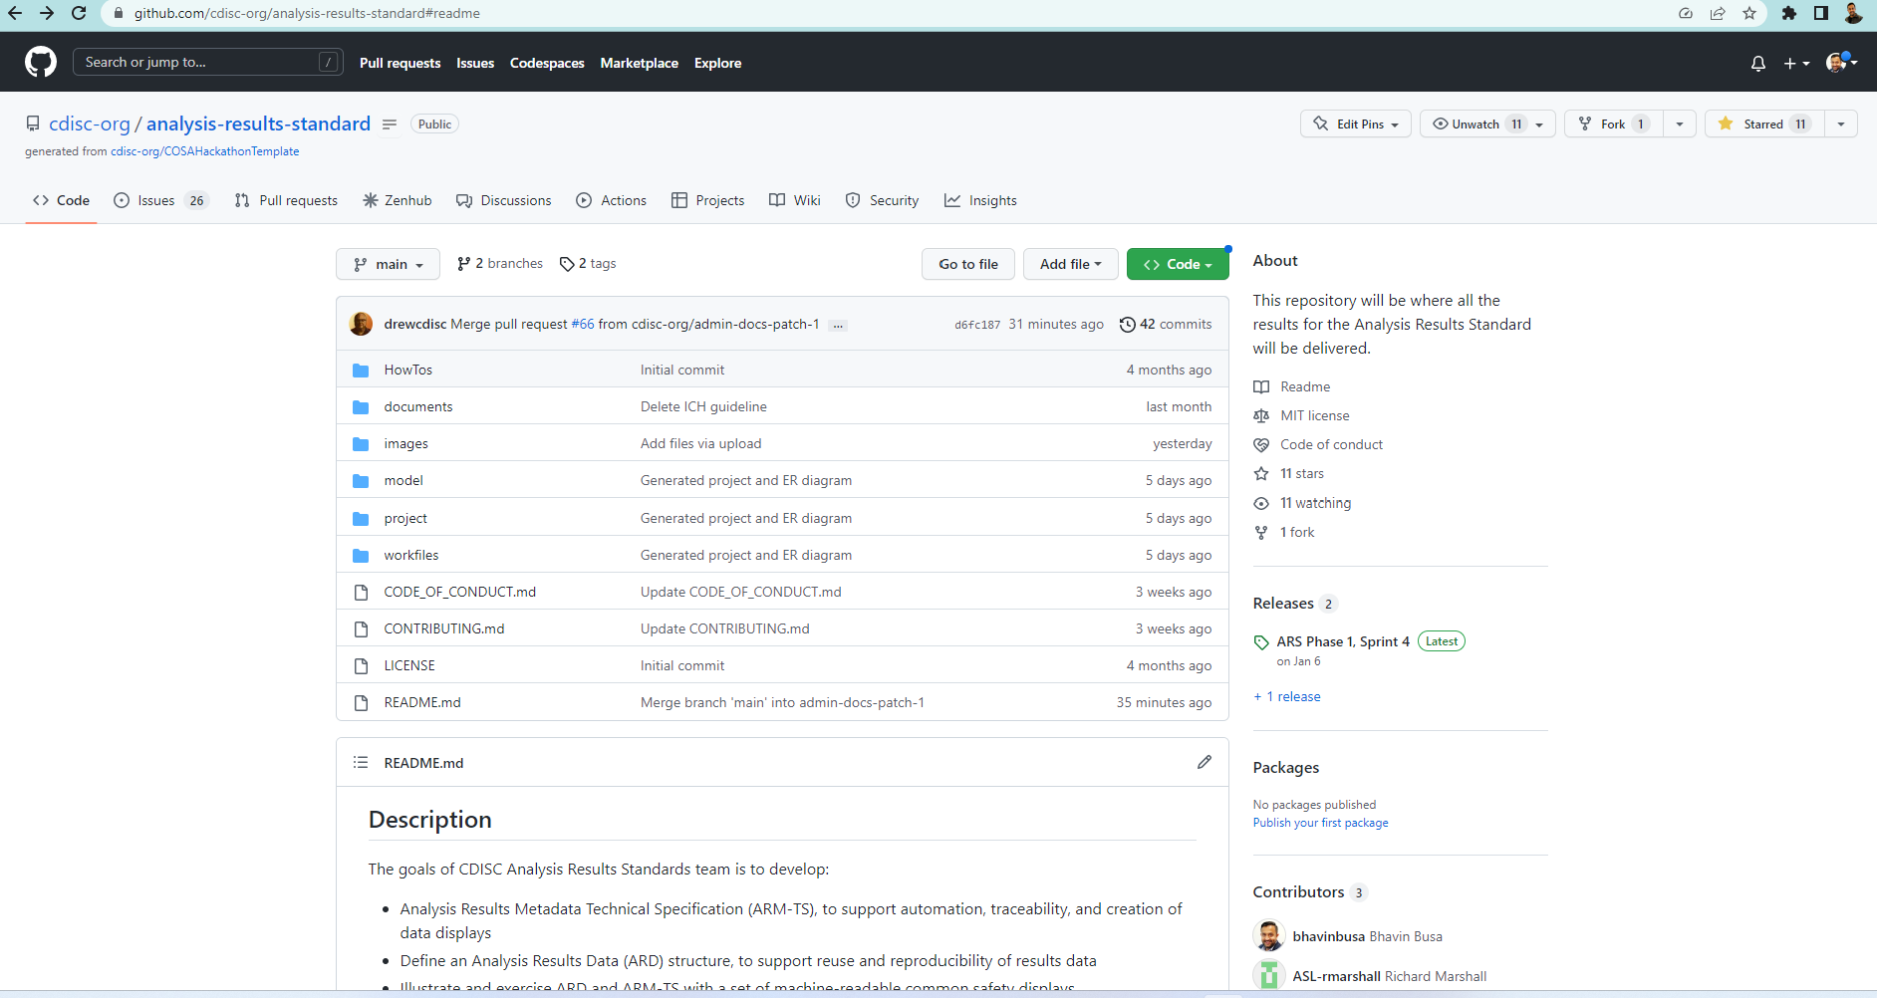
Analysis Results Standard Repo on GitHub
https://github.com/cdisc-org/analysis-results-standard
Notes:
https://github.com/cdisc-org/analysis-results-standard/blob/main/project/docs/ars_ldm.md

Slide 19
Q & A

Slide 20
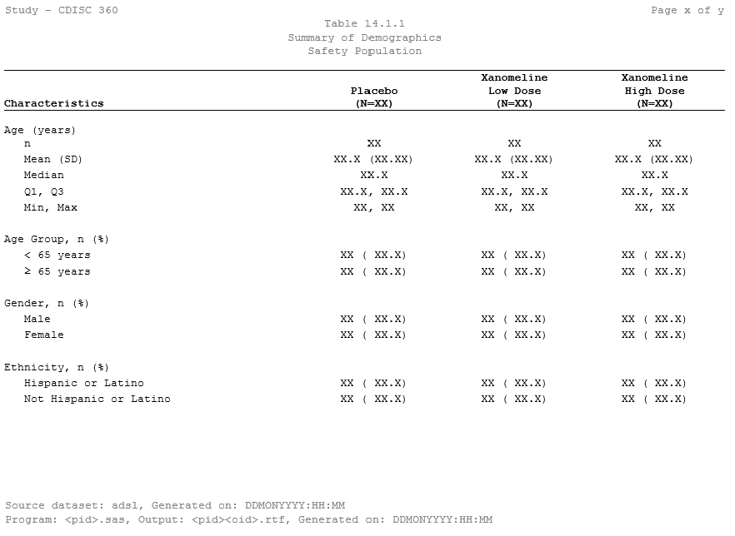
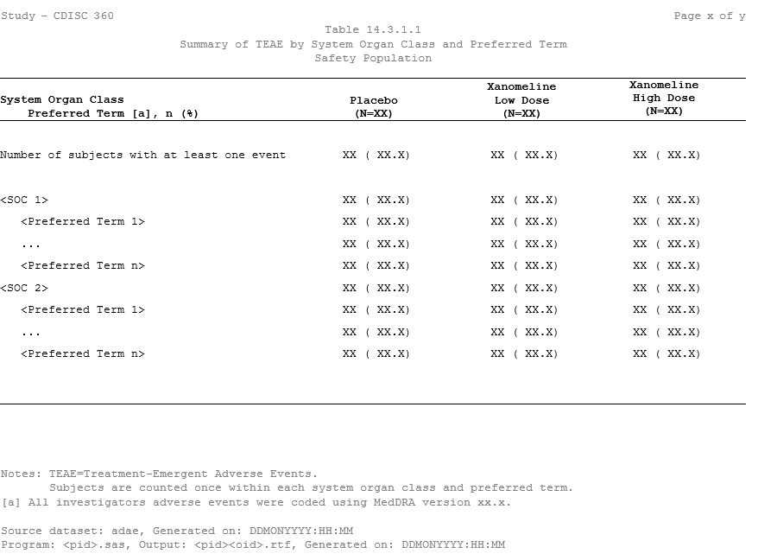
Review Examples
Summary of Demographics
Summary of TEAE by SOC and PT
https://github.com/cdisc-org/analysis-results-standard/tree/main/workfiles/examples/PHUSE%20Connect%20Workshop

Slide 21
ARS model will drive automation and open-source tool development

Slide 22
Reference Implementation Example

Slide 23




TFL Designer
An industry leading solution to automate tables, figures, and listings (TFL) design and generation process
CDISC COSA approved
Align with CDISC ARS logical model
Community beta version release (access limited to beta users): Apr 2023

Slide 24




Sponsor
Study
MDR
Industry Standards
Sponsor Standards
Study Definitions
Protocol, CRF & SAP
Analysis Results Standards Metamodel and APIs
Select TFL of Interest
Select Analysis Concepts, Methods, Terminology & TFL Display (Template)
Study ADaM, ARD and TFL outputs
Customize TFL Layout & Metadata
Machine-readable ARM + TFL Shells (JSON & XML formats)
Automation Engine (SAS, R or other Software products)
* Open-Source TFL Designer, Bhavin Busa
Link to GitHub: https://github.com/bhavinbusa/tfldesigner

Slide 25
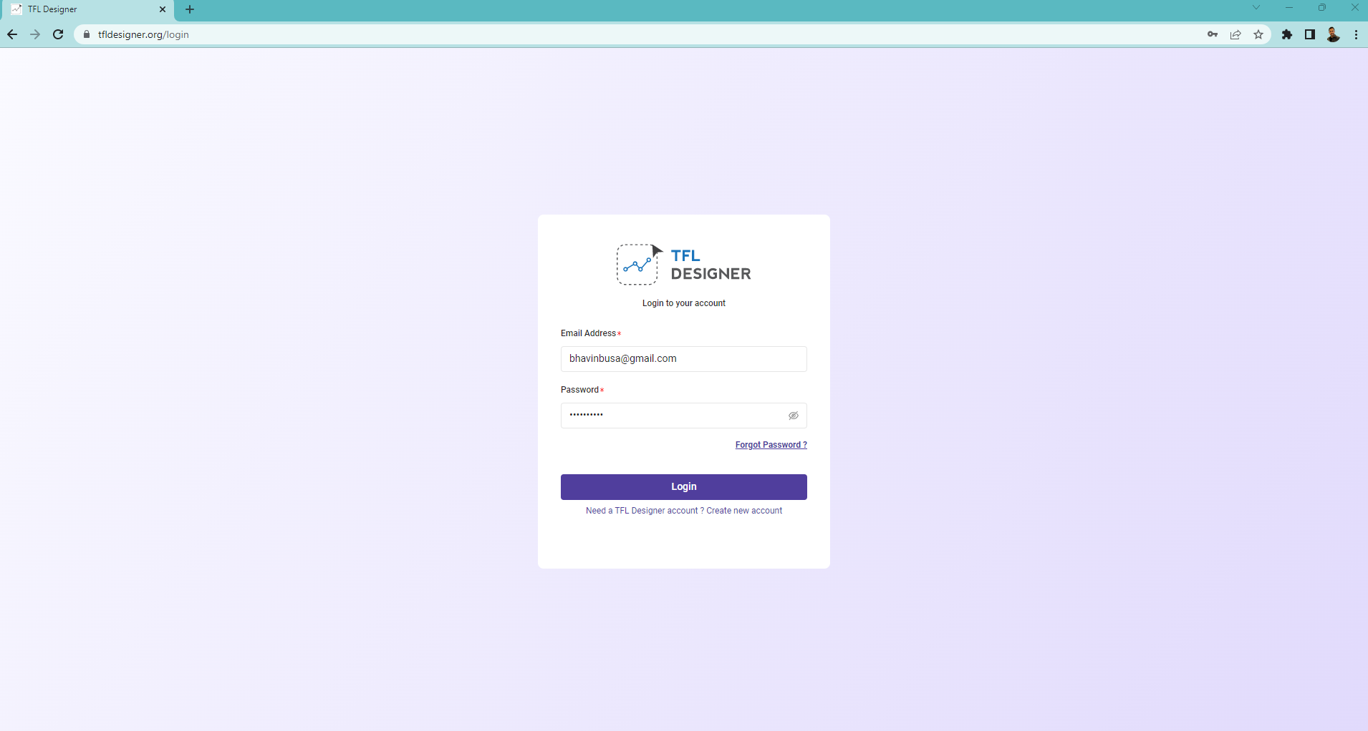
TFL Designer* (MVP Demo)
*Community beta version release (access limited to beta users): Apr 2023

Slide 26
ARS Roadmap
MVP for v1.0 (Summer 2023)
Logical Model of to support ARM TS/ARD
Four common safety examples based on team developed tables
Demographics
Adverse Events
Vital signs
Future Development
Expanded use cases
Machine readable TFLs available on the CDISC website
Conformance rules
Terminology

Slide 27
Q & A

Slide 28
Contact Details
Bhavin Busa
ARS Product Owner & Co-Lead
bhavinbusa@gmail.com
Bess LeRoy
ARS Co-Lead
bleroy@cdisc.org
CDISC ARS GitHub Repo:
https://github.com/cdisc-org/analysis-results-standard

